Slide 1


Slide 2
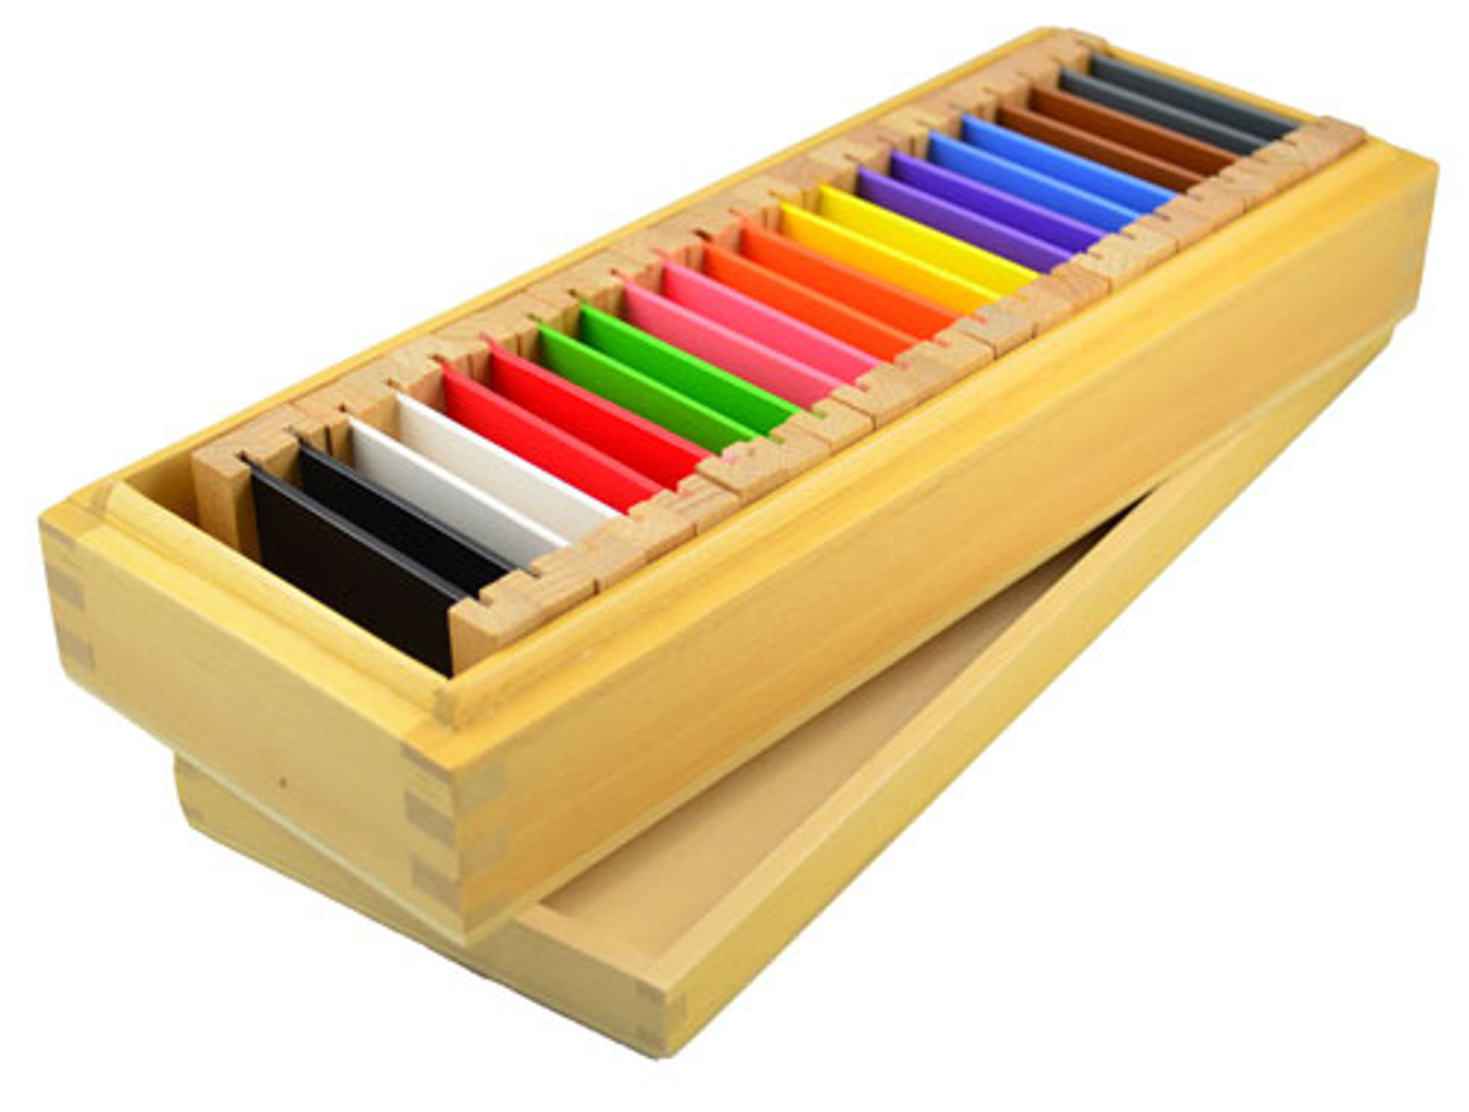
Learning English
the Montessori way
for ages 3 to 6
COLOURS
Parents & Kids together in one classrom
Powerpoint interactive presentation

Slide 3
RED
BLUE
YELLOW
It is red.
It is blue.
It is yellow.
RED
BLUE
YELLOW

Slide 4
RED

Slide 5
BLUE

Slide 6
YELLOW

Slide 7
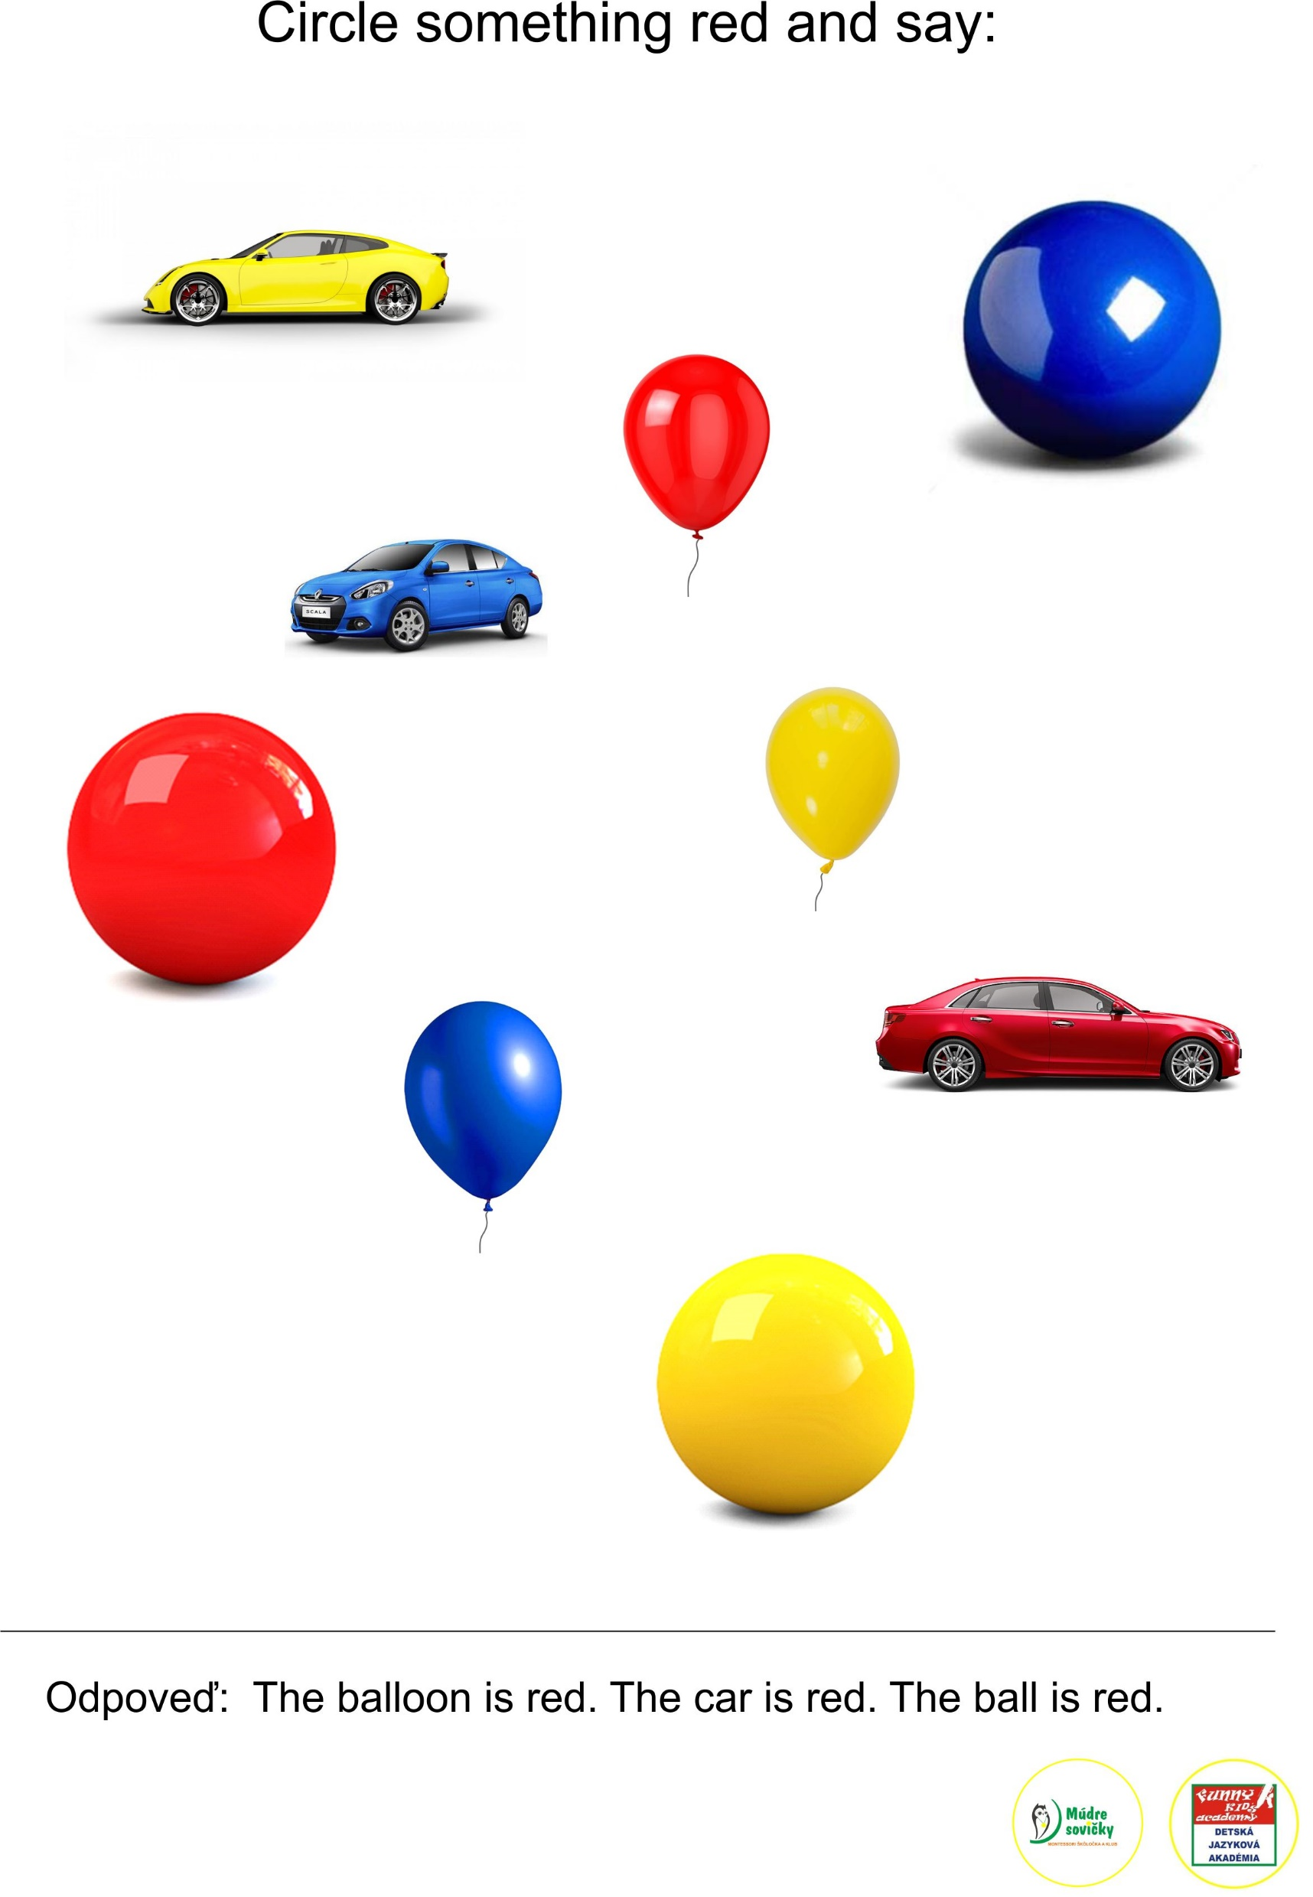
The balloon is red.
What is red?
The car is red.
The ball is red.

Slide 8
The ball is blue.
What is blue?
The car is blue.
The balloon is blue.

Slide 9
The car is yellow.
What is yellow?
The balloon is yellow.
The ball is yellow.

Slide 10
GREEN
ORANGE
PURPLE
It is green.
It is orange.
It is purple.
GREEN
ORANGE
PURPLE

Slide 11
GREEN

Slide 12
ORANGE

Slide 13
PURPLE

Slide 14


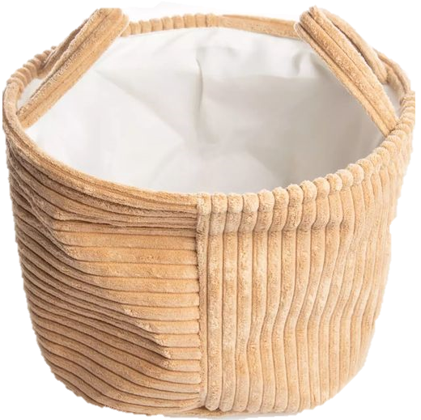

a pencil
What´s
in my basket?
a strawberry
an umbrella

Slide 15
What is yellow?
The pencil is yellow.
What is blue?
The umbrella is blue.
What is red?
The strawberry is red.

Slide 16


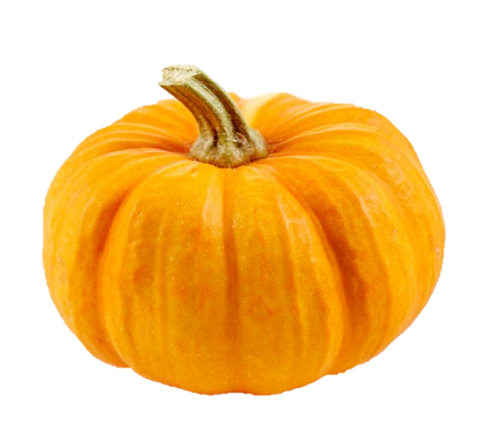
What else is
in my basket?
a flower
a pumpkin
A baloon

Slide 17
What is purple?
The flower is purple.
What is green?
The baloon is green.
What is orange?
The pumpkin is orange.

Slide 18
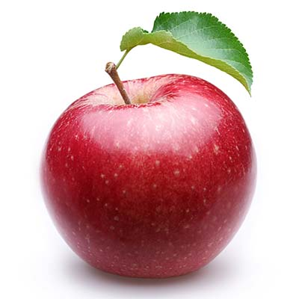
It is an apple.

Slide 19
What colour is the apple?
RED
The
is RED.

Slide 20
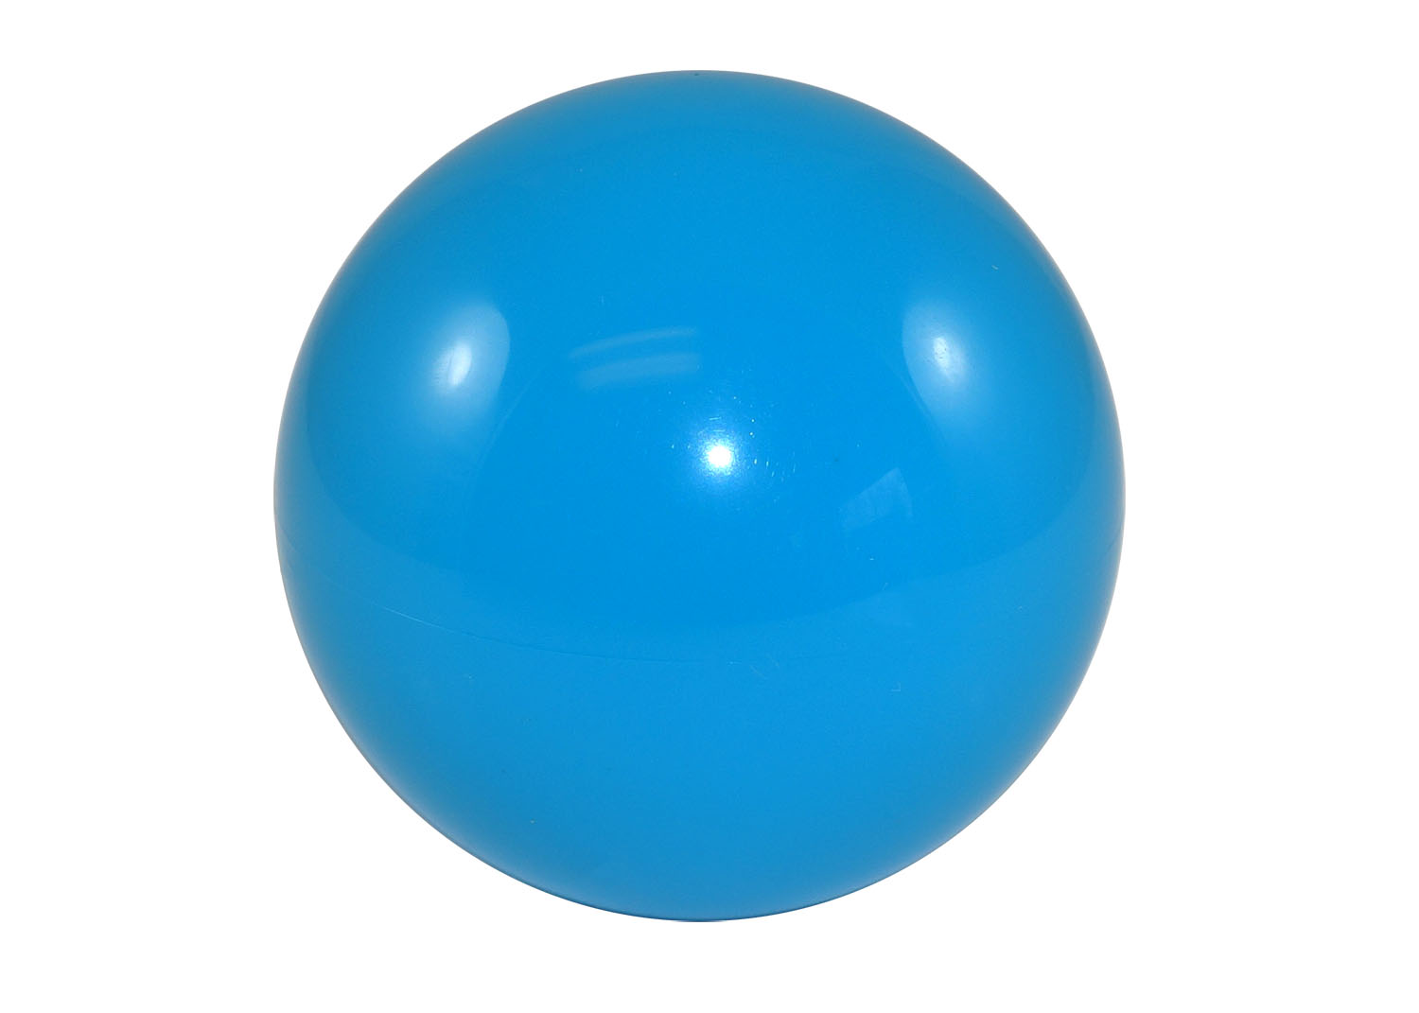
It is a ball.

Slide 21
What colour is the ball?
BLUE
The
is BLUE.

Slide 22
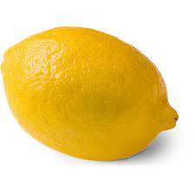
It is a lemon.

Slide 23
What colour is the lemon?
YELLOW
The
is YELLOW.

Slide 24
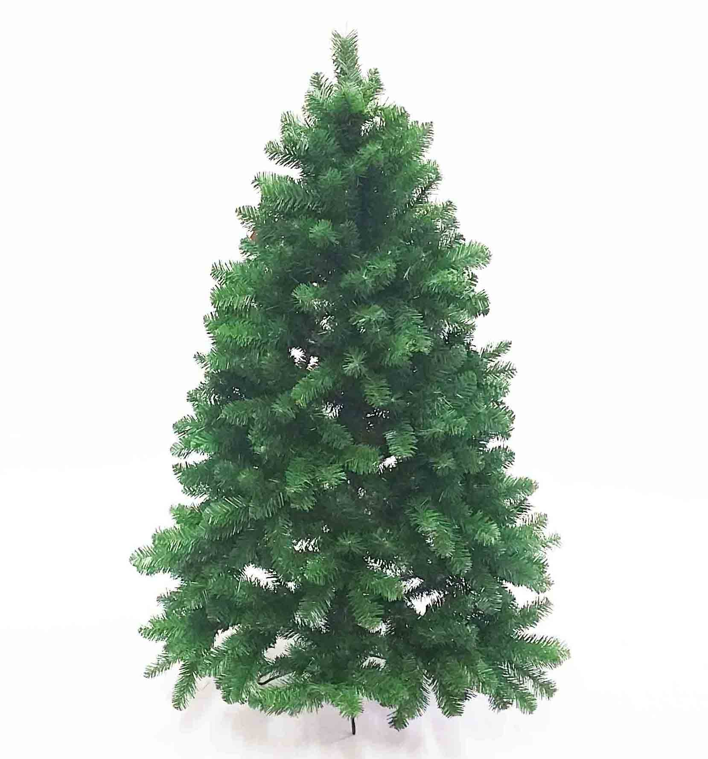
It is a tree.

Slide 25
What colour is the tree?
GREEN
The
is GREEN.

Slide 26
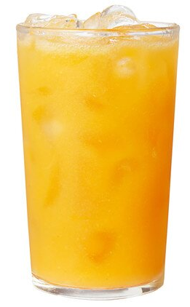
It is juice.

Slide 27
What colour is the juice?
ORANGE
The
is ORANGE.

Slide 28
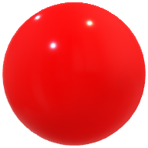
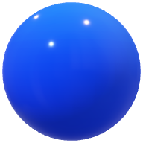
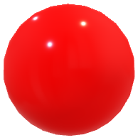
What comes next?
What comes next ?
A red ball
A blue ball

Slide 29
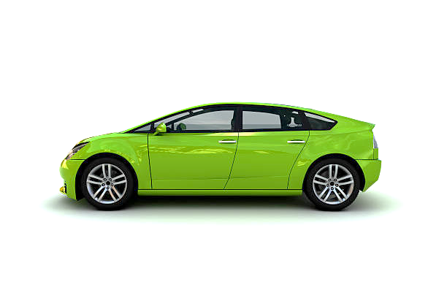
What comes next?
What comes next ?
A yellow car
A green car

Slide 30

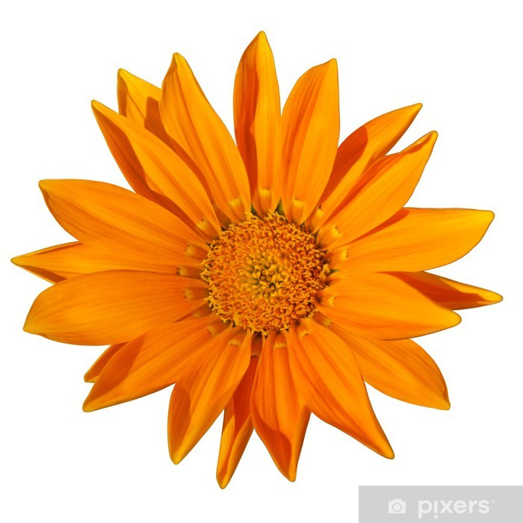
What comes next?
What comes
next ?
A purple flower
An orange flower

Slide 31
Let´s play a game.
„What colour is missing?“
What colour is missing?

Slide 32
Let´s play a game.
„What colour is missing?“
What colour is missing?

Slide 33

Memory game - Let´s play

Slide 34
Good job
BYE-BYE

